Slide 1
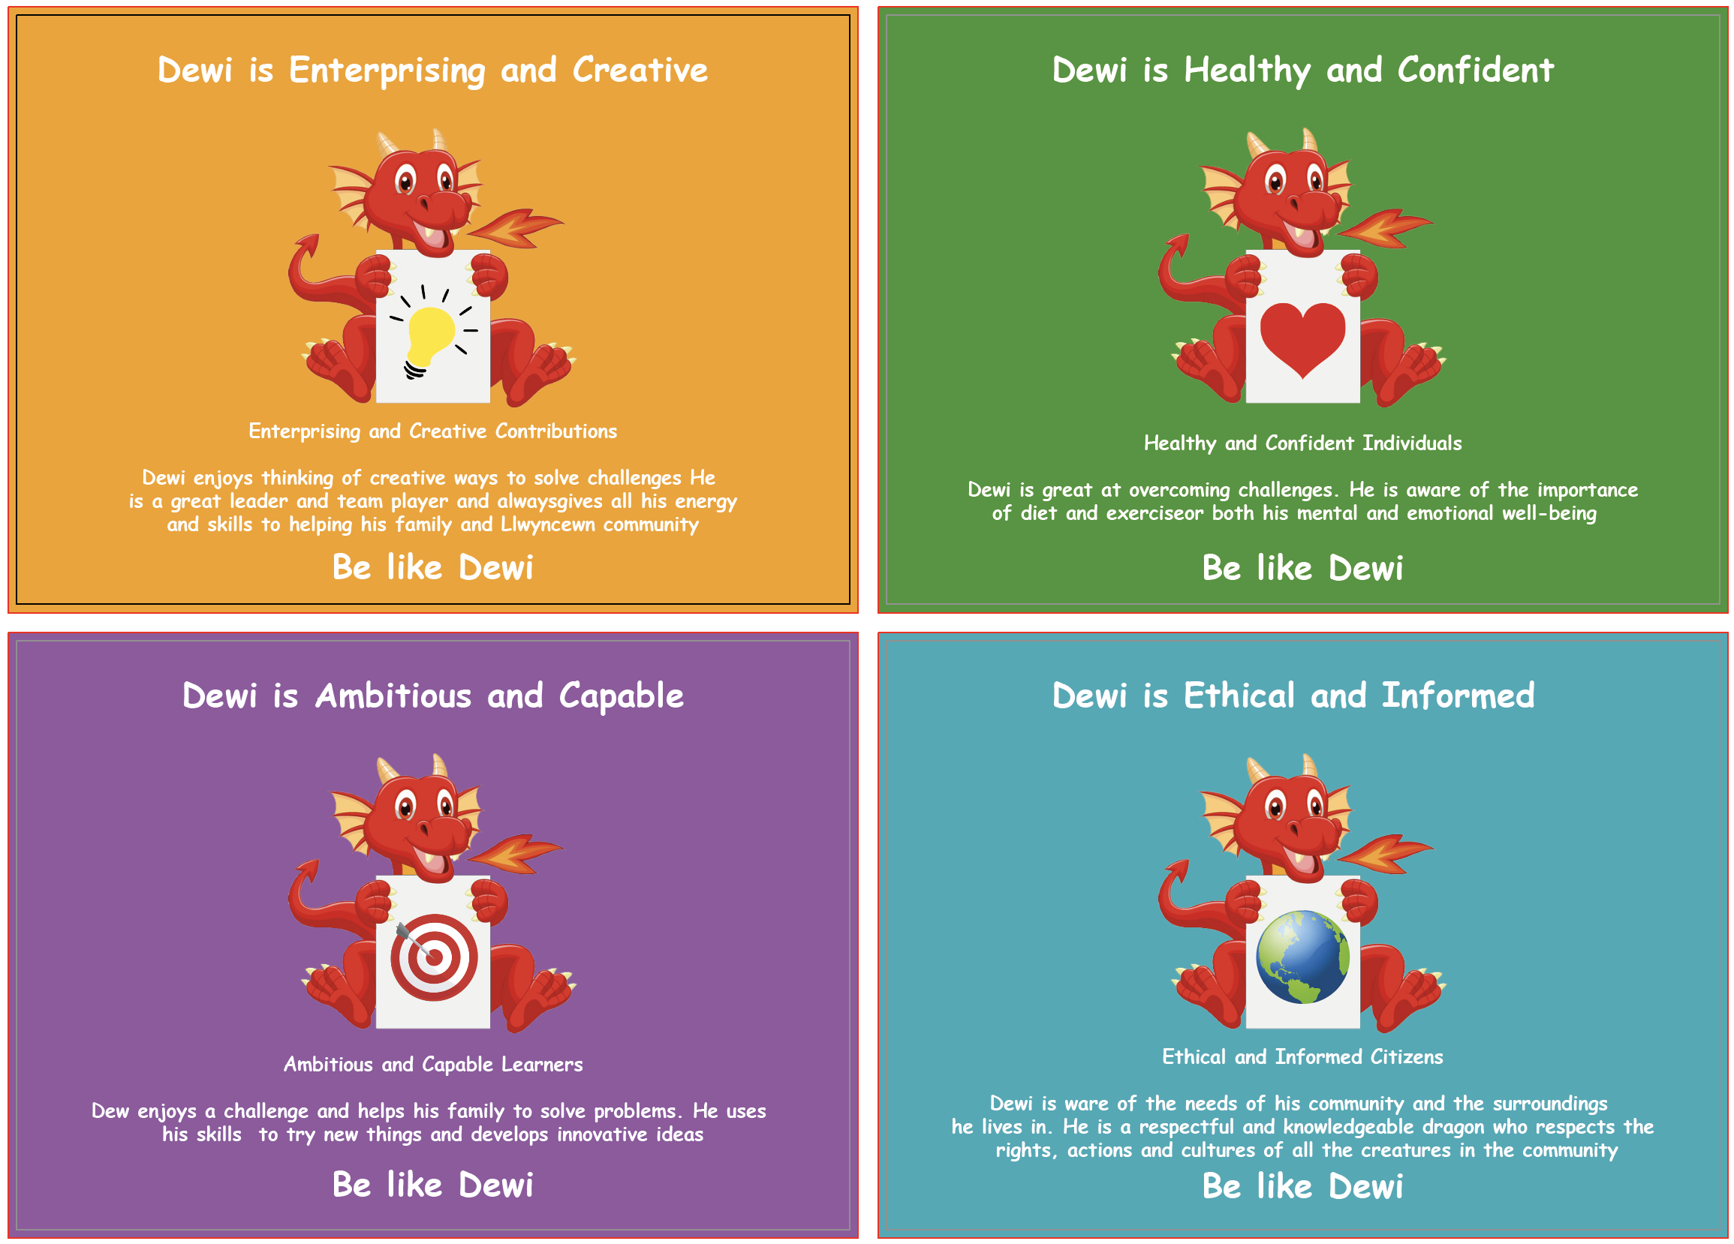

Llwyncrwn Primary School
Llais Llwyncrwn -
Our Curriculum

Slide 2
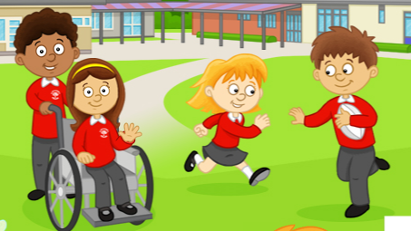
Mission Statement
YMLAEN GYDA’N GILYDD
-
FORWARD TOGETHER

Slide 3
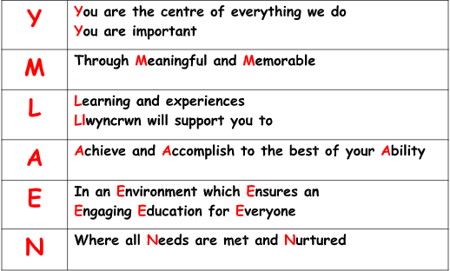

Slide 4
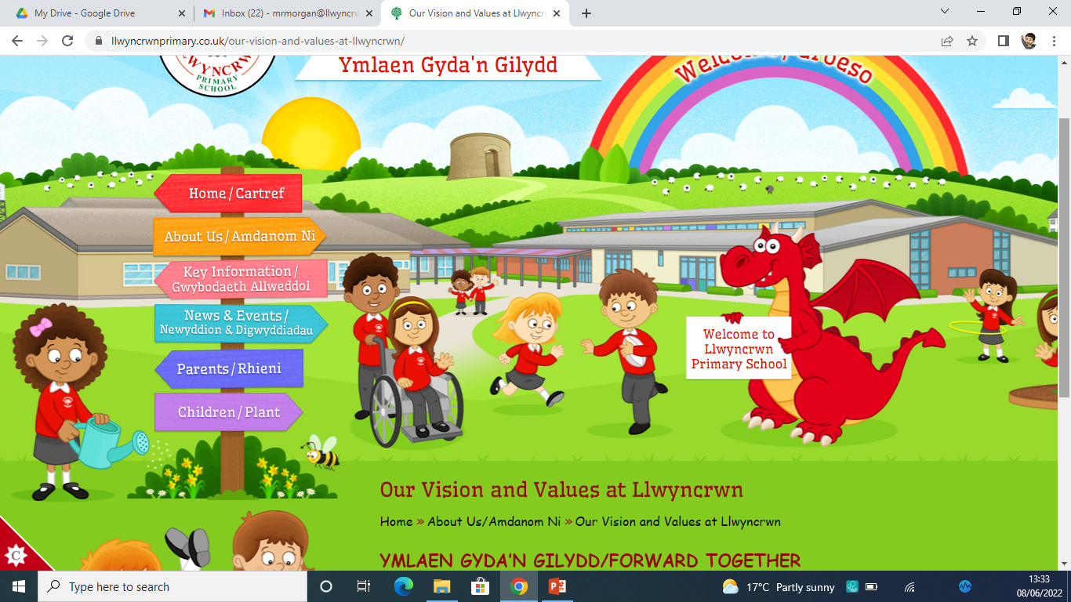
Vision and Values
Our vision at Llwyncrwn Primary School is:
“To be a successful, child-centered school at the heart of our community. We aim to be a school where pupils, staff, governors, parents and carers work actively together, to ensure a rich, inspiring and engaging education; enabling every child to become a life-long learner, aspiring to high standards of achievement in all aspects of their life”.

Slide 5
Croeso i Ysgol Llwyncrwn
Across all Areas of Learning and Experience (AoLEs), the application of numeracy, literacy and digital competence is robustly planned for. Teachers are expected to plan and deliver engaging and challenging learning experiences pitched appropriately to the learners needs.
In addition to literacy, numeracy and digital competence, teachers plan for incidental Welsh and opportunities to address relationships and sexuality education in line with the new Curriculum for Wales.
Llwyncrwn is an equitable and inclusive school, not only do we want to develop our pupils academically, but believe our role as a school is to also promote our pupils as good citizens in their community; with high levels of well-being and self-esteem too. Well-being permeates all aspects of a pupils time at Llwyncrwn, learners can develop positive, informed behaviours that encourage them both to care for and respect themselves and others. These behaviours support learners’ sense of self-worth, their overall mood, energy levels and confidence.

Slide 6
Curriculum for Wales 2022
Curriculum for Wales 2022 organises learning around six areas of learning and experience. Each of the areas of learning and experience has been designed to support learners to realise the four purposes of the curriculum. They are intended to promote collaboration and cross-disciplinary school-level curriculum development and design.
All teachers plan for the cross-curricular responsibilities of literacy, numeracy and digital competence to support almost all learning. These are essential for learners to be able to participate successfully and confidently in the modern world.
For more information regarding the Curriculum for Wales 2022 please refer to the Key Information page of our website, under the sub-heading ‘Curriculum For Wales’.

Slide 7
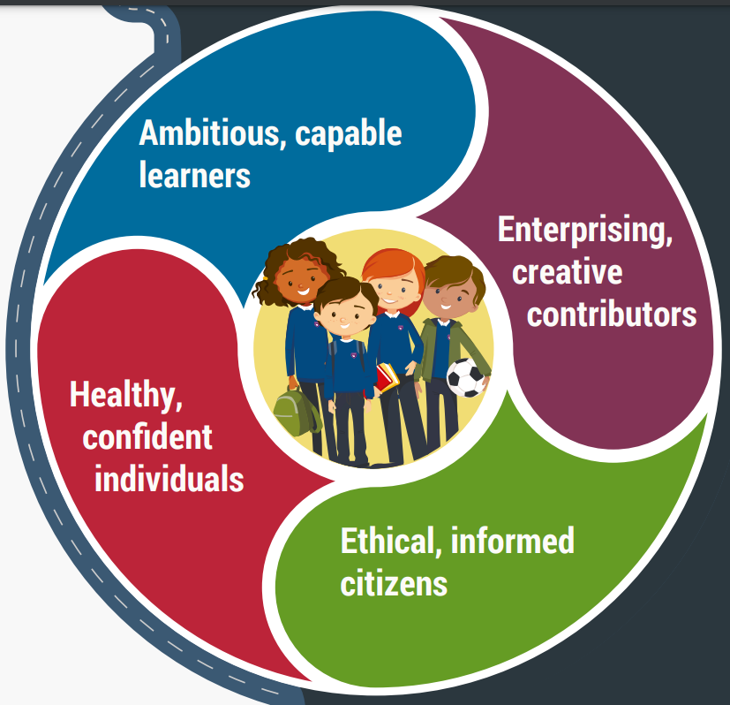
Four Purposes
The Four Purposes are at the heart of our new curriculum. They will be the starting point for all decisions on the content and experiences developed as part of the curriculum.
Our Learning Sherriff’s gathered the ideas of children across the school to find out what the Four Purposes meant to our learners. Through pupil voice, it was decided that our school mascot, Dewi the Dragon would represent the Four Purposes. The Learning Sherriff’s developed the Four Purposes in child friendly speak with children throughout our school aiming to ‘Be like Dewi!’.

Slide 8
Enterprising and Creative Contributors
Dewi enjoys thinking of creative ways to solve challenges. He is a great leader and team player and always gives all his energy and skills to helping his family and Llwyncrwn community.
Be like Dewi!

Slide 9
Healthy and Confident Individuals
Dewi is great at overcoming challenges. He is aware of the importance of diet and exercise for both his mental and emotional well-being.
Be like Dewi!

Slide 10
Ambitious and Capable Learners
Dewi enjoys a challenge and helps his famliy to solve problems. He uses his skills to try new things and develops innovative ideas.
Be like Dewi!

Slide 11
Ethical and Informed Citizens
Dewi is aware of the needs of his community and the surroundings he lives in. He is a respectful and knowledgeable dragon who respects the rights, actions and cultures of all the creatures in the community.
Be like Dewi!

Slide 12
12 Pedagogical Principles
At Llwyncrwn we teach through a range of approaches, not restricted to, but including those outlined in the 12 Pedagogical Principles.
Core Purposes
Mindset and the Power of Effort
Blended Teaching
Deepening Thinking
Building on Prior Knowledge
Meaningful and Authentic
Assessment for
Learning
Making Powerful Connections
Cross Curricular
Learning to Learn
Positive
Relationships
Collaboration

Slide 13
Considerations for Planning
We believe that to get the best out of all our learners we have to offer rich and exciting experiences. We are committed to developing a curriculum which engages, enthuses and inspires our pupils and staff. We encourage teachers to have the freedom to teach in ways they feel will have the best outcomes for their learners. We have a strong emphasis on the acquisition and application of skills and knowledge through experiential and active learning.
All children contribute to their curriculum, ensuring that they have opportunities to influence their learning throughout each term. Each term starts with a launch day to reveal the new topic. This could be through school based activities, mystery trips and the use of visitors to ensure effective learner engagement from the first day of each term. Wherever possible we consider Cynefin, a Welsh word that means a place of multiple belongings, and promotes the use of the community that surrounds the learners.

Slide 14
Six Areas of Learning and Experience (AoLEs)
The new curriculum is about helping our pupils connect their learning. As well as learning literacy, numeracy and digital skills, there will be six areas of learning and experience. Everything that children learn will connect to these areas.
The curriculum we have developed will also cover:
● human rights and the United Nations Convention on the Rights of the Child
● diversity and respecting differences
● experiences and skills for careers and the workplace
● local, national and international aspects of all learning.
● Relationships and Sexuality Education

Slide 15
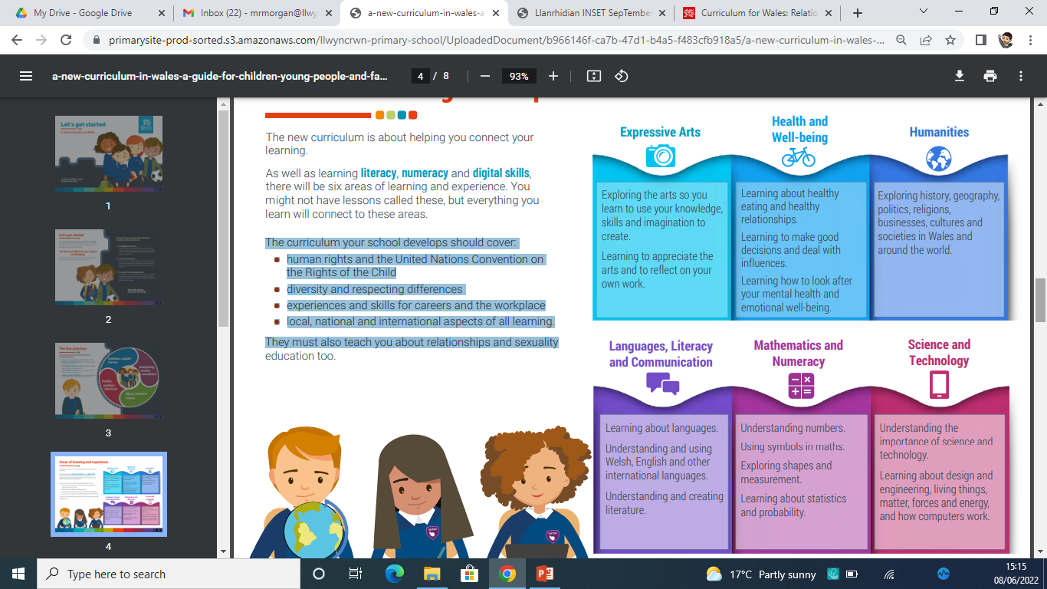
Areas of learning and what they mean for our pupils…

Slide 16
Long-term Curriculum Planning
To ensure we provide pupils at Llwyncrwn with a broad and balanced curriculum we focus on specific AoLEs each term. This approach allows us to explore the Statements of What Matters ensuring that children are provided with a range of knowledge, skills and experiences.
The needs of all stakeholders (pupils, staff, parents and the wider community) are taken into consideration when planning the knowledge, skills and experiences that form our curriculum. The curriculum is carefully planned out to ensure continuity, progression and an increasing breadth and depth of knowledge as children move throughout the continuum.
Although specific AoLEs are chosen as the termly ‘focus’, these are not taught in isolation, with learners consistently making connections across AoLEs where they will be expected to refer back to prior knowledge, skills and experiences.
The new curriculum is a journey – building pupils knowledge, skills and experiences. Our curriculum is planned to be responsive to the needs of our children. There may be times when they:
● move forward and progress quickly
● slow down to ensure understanding
● take a detour because they discover something that interests them

Slide 17
Whole School Topics
To ensure coverage of the Statements of What Matters we operate on a two year cycle. Although we have whole-school ‘umbrella topics’, class teachers work with their pupils to develop class sub-topics. This gives teachers increased autonomy, where they draw on their skills and experience to ensure that they deliver a curriculum best suited to children in their care. Children are heavily involved in this process to make sure that we are providing them with a curriculum that is engaging and relevant to their needs and interests. This is apparent through our EPIC planning approach.
Cycle One
Autumn Term | Spring Term | Summer Term
This is Me | Let’s Explore | Iechyd Da!
Cycle Two
Autumn Term | Spring Term | Summer Term
Yma o Hyd | STEM-tastic! | Step Back in Time

Slide 18
Assessment and Progression
Learner progression along a continuum of learning from ages 3 to 16 is central to Curriculum for Wales. Assessment plays a fundamental role in enabling each individual learner to make progress at an appropriate pace, ensuring they are supported and challenged accordingly.
Our curriculum will ensure that children build on skills they have previously learnt through different learning opportunities
Our curriculum ensures that learners will make meaningful progress
Our curriculum will ensure the child is always at the centre of their learning
All learners will be observed on entry into school to get a whole picture of what they can already do to ensure that we can aid them in making meaningful progress from their individual point
Assessment will be used to inform future planning
Assessment will be embedded as an intrinsic part of learning and teaching

Slide 19
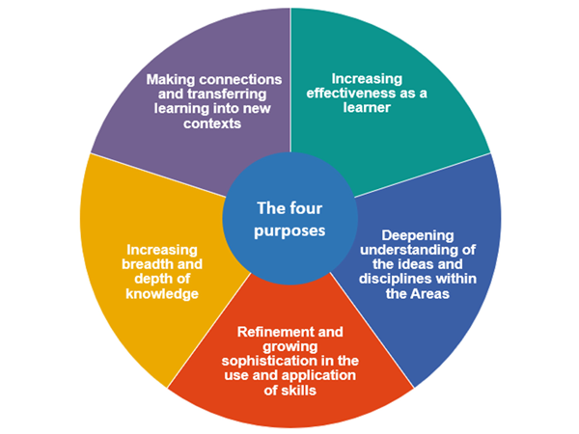
Five principles of progression underpin progression across all Areas.

Slide 20

Curriculum Review
We will constantly review and reflect on our curriculum and adapt and make changes as we need to.
Parents
Community Voice
Governors
Staff
School Development Plan
Monitoring
Pupil Voice

Slide 21

Inclusion
Speech and Language
All children
All religions
Deaf aware
British Sign Language
Children’s Rights
ACEs
All ethnicities
ASD aware
All abilities

Slide 22
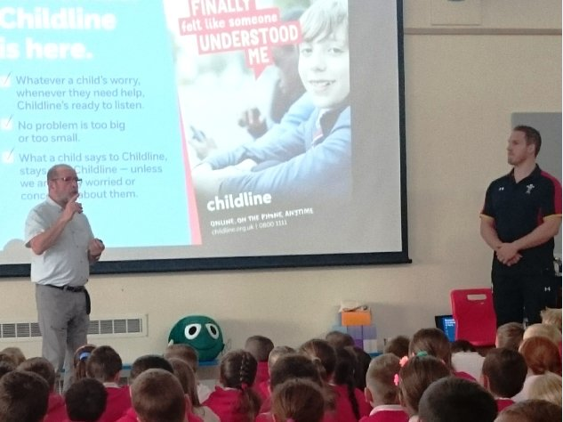
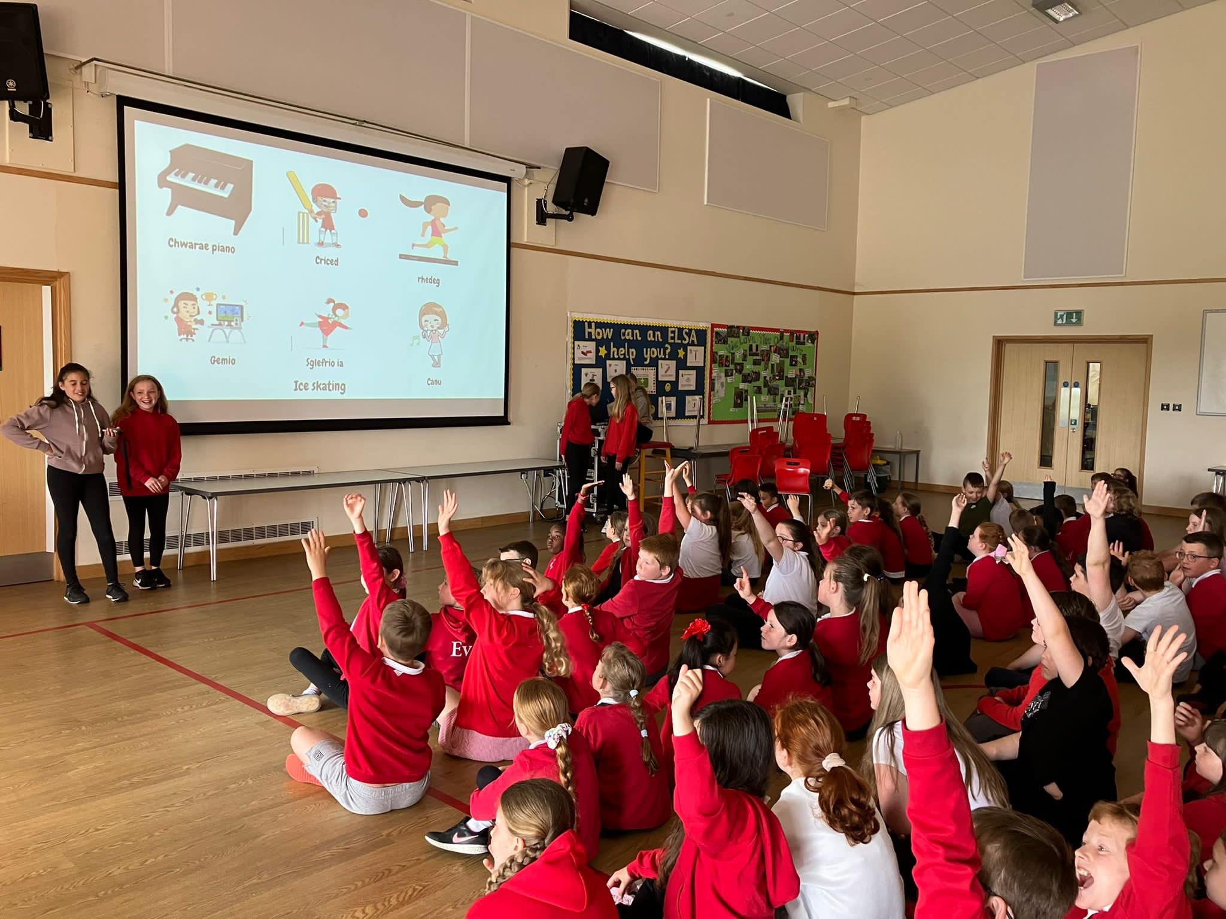
Assemblies
At Llwyncrwn during assemblies we aim to continue delivering a broad and balanced curriculum for our pupils. Assemblies are planned and delivered with the aims of the Curriculum for Wales in mind. The main foci for our assemblies are:
Religion, Values and Ethics
Cynefin and the Welsh language
Children's Rights
Celebrations
Eco Schools
In addition to staff assemblies, the above foci are also addressed by members of the community and external organisations attending the school to work alongside our children.
As part of our strong and ongoing commitment to pupil voice, children are also given opportunities to deliver assemblies to aid the above purposes.

Slide 23
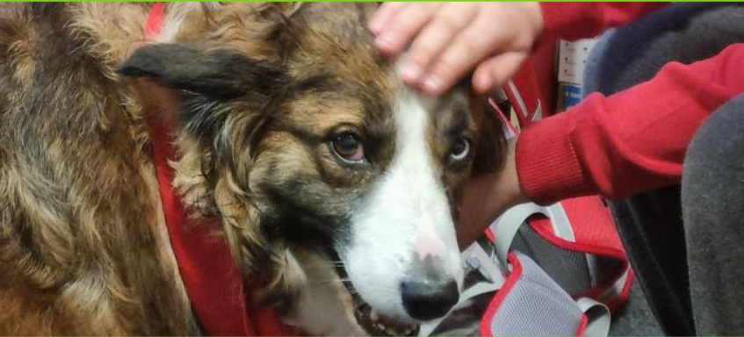
Whole School Approach to
Emotional & Mental Well-being
At Llwyncrwn, we aim to promote positive emotional and mental well-being for our whole school community (pupils, staff, parents and carers), and recognise how important emotional and mental well-being is to our lives in just the same way as physical health. We recognise that pupils and staffs’ emotional and mental well-being is a crucial factor in their overall wellbeing and can affect their teaching, learning and achievement. All pupils and staff go through ‘ups and downs’ during their time at school and some face significant life events.
To promote and nurture emotional and mental well-being in our school we:
provide individual and small group ELSA support
have a school therapy dog to support pupil well-being
are a Trauma Informed School
use Restorative Approaches
are a PERMA school
are a SHINE pilot school
support staff well-being through CARI

Slide 24
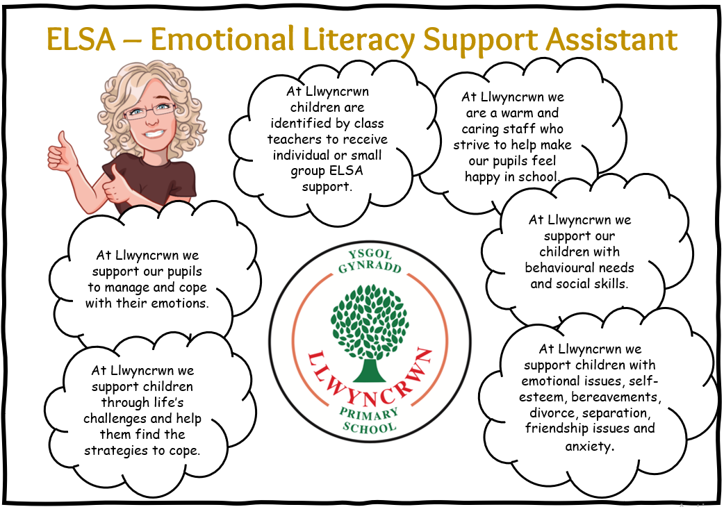

Slide 25
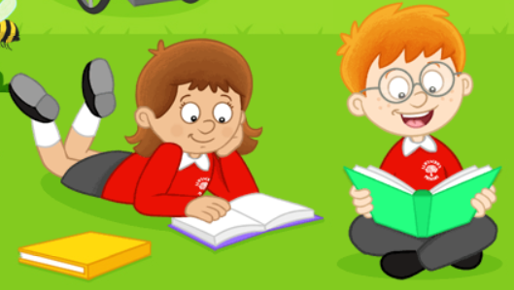
Family Support
At Llwyncrwn we have appointed a school Family Liaison Officer (FLO) after identifying the need to offer support to our families. The FLO works to provide pastoral support to parents/carers to help with any issues that they may have in supporting children both at home and in school. The FLO works to encourage parental involvement within the school, signposting to agencies (where appropriate) and supporting children in school. As well as this the FLO works to help improve attendance and wellbeing throughout the school.
Should any parents have personal concerns or a school related issue, then the FLO offers support. The FLO has access to a number of agencies who may be able to provide assistance to families.
The FLO also liaises with all school staff where necessary and appropriate, always in the best interests of the children and their families. The FLO works impartially and confidentially in a non-judgemental manner, providing an understanding “listening ear.”

