Slide 1
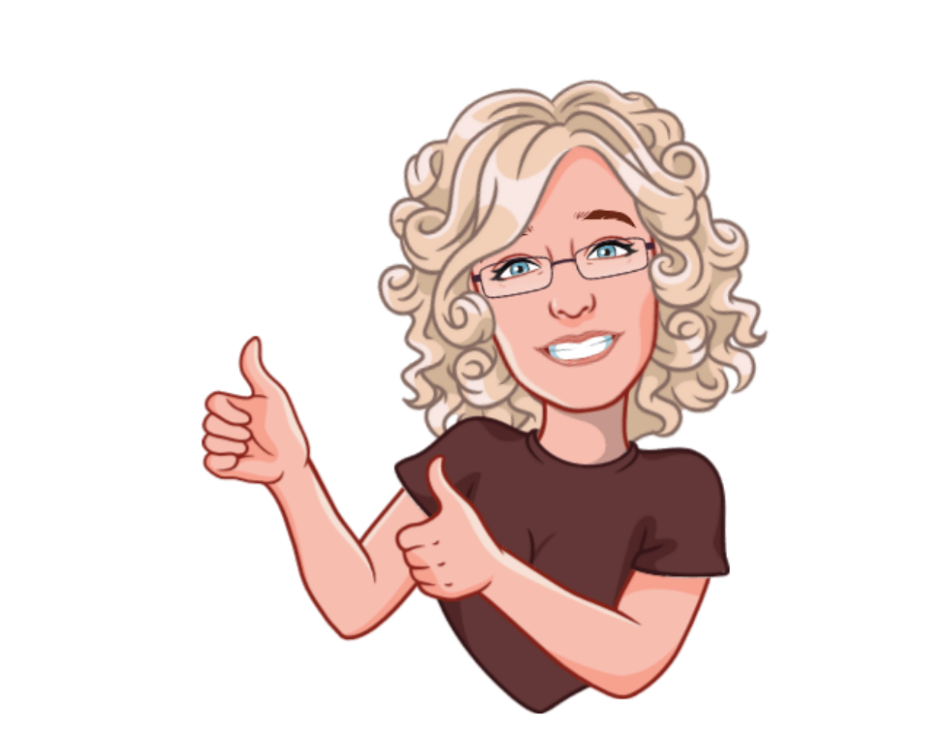
ELSA – Emotional Literacy Support Assistant
Can work with your child individually or in a small group.
Warm and caring person who wants to help make your child feel happy in school.
Specialist Teaching Assistant with a wealth of knowledge and experience working with children.
Can support your child with behaviour and social skills.
Can support your child with emotional issues, self-esteem, bereavements, divorce, separation, friendship issues and anxiety.
Can support your child to manage and cope with their emotions.
Able to support your children through life’s challenges and help them find the strategies to cope.
Mrs Hunt
ELSA
©ELSA SUPPORT 2019

